Slide 1

Fred A. Toomer Elementary
Notes:
Good Morning/Afternoon! Today we begin the process of planning our school’s budget for FY20. I know we are all here for the same reason and that is ensuring success for all (enter school name) students. This meeting is to provide an overview of the draft budget and for you to give feedback on the draft budget.

Slide 2
Norms
This is a meeting of the GO Team. Only members of the team may participate in the discussion. Any members of the public present are here to quietly observe.
We will follow the agenda as noticed to the public and stay on task.
We invite and welcome contributions of every member and listen to each other.
We will respect all ideas and assume good intentions.

Slide 3



GO Team Budget Development Process
YOUR SCHOOL STRATEGIC PLAN…
is your roadmap and your role. It is your direction, your priorities, your vision, your present, your future.
Step 1: Data Review
Step 2: Strategic Plan Review
Step 3: Budget Parameters
Step 4: Budget Choices
Notes:
Today I will provide an overview of the budget allocations for FY20. We will begin the work of funding the strategic priorities we agreed upon during our strategic review meeting. (IF YOU HAVE NOT DECIDED ON YOUR PRIORITIES, YOU WILL SAY – WE WILL DECIDE ON OUR PRIORITIES AND THEN DISCUSS ALLOCATING FUNDS TO ADDRESS THOSE PRIORITIES).

Slide 4
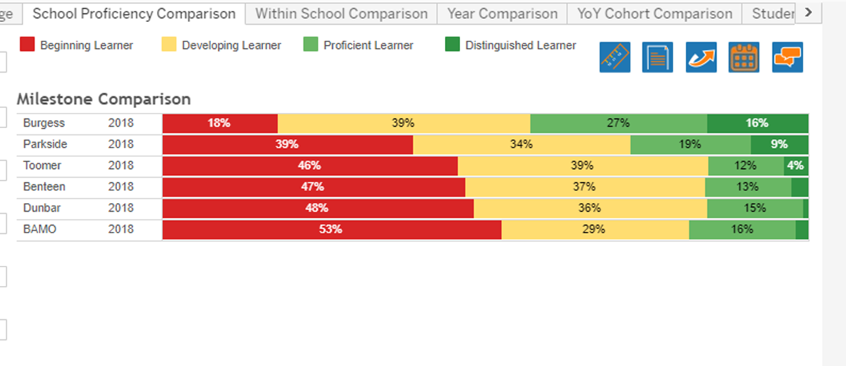
Toomer Comparison to Jackson Cluster

Slide 5
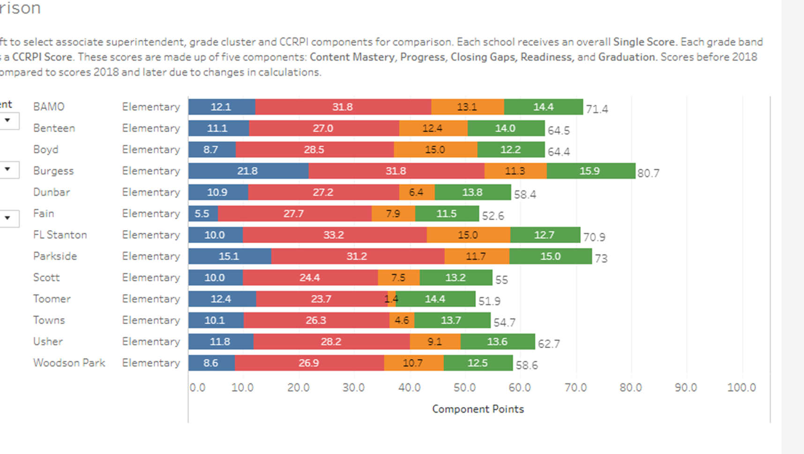
Components of CCRPI
Content Mastery
Closing Gaps
Progress
Readiness

Slide 6
Closing the Gaps- What do you notice?

Slide 7
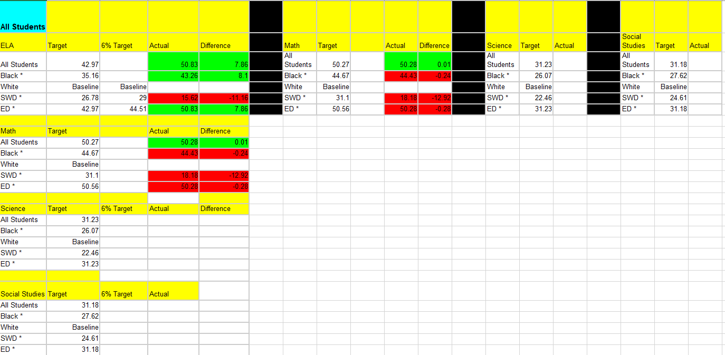
ELA and Math Targets
2018-2019

Slide 8
GO Team Budget Development Process
YOUR SCHOOL STRATEGIC PLAN…
is your roadmap and your role. It is your direction, your priorities, your vision, your present, your future.
Step 1: Data Review
Step 2: Strategic Plan Review
Step 3: Budget Parameters
Step 4: Budget Choices
Notes:
Today I will provide an overview of the budget allocations for FY20. We will begin the work of funding the strategic priorities we agreed upon during our strategic review meeting. (IF YOU HAVE NOT DECIDED ON YOUR PRIORITIES, YOU WILL SAY – WE WILL DECIDE ON OUR PRIORITIES AND THEN DISCUSS ALLOCATING FUNDS TO ADDRESS THOSE PRIORITIES).

Slide 9
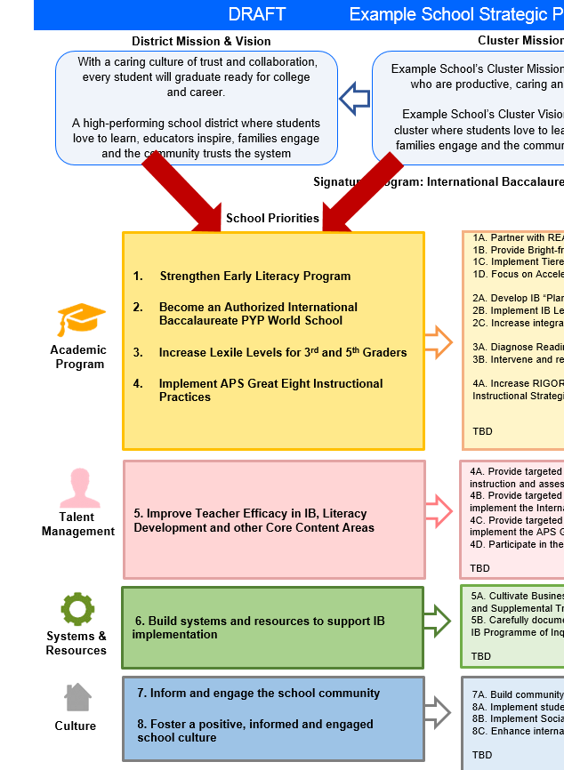
FY20 Budget Development Process
Principal’s Role
Design the budget and propose operational changes that can raise student achievement
Flesh out strategies, implement and manage them at the school level
Focus on the day-to-day operations
Serve as the expert on the school
Hire quality instructional and support personnel
The GO Team’s Role:
Focus on the big picture (positions and resources, not people)
Ensure that the budget is aligned to the school’s mission and vision and that resources are allocated to support key strategic priorities

Slide 10
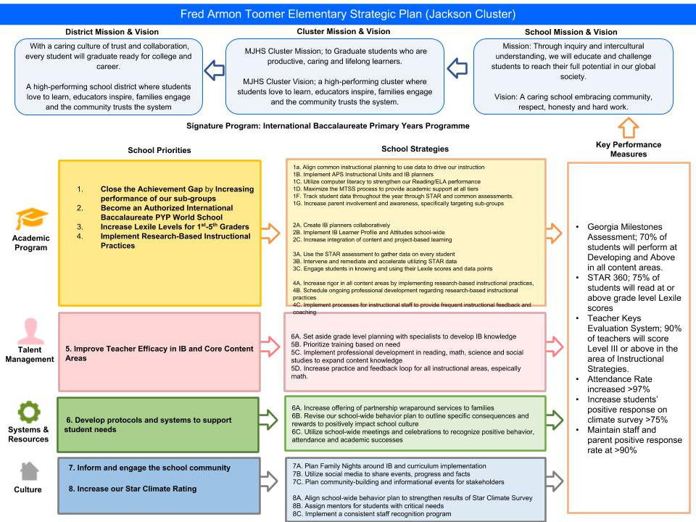

Toomer Elementary Strategic Plan
Notes:
You should have a copy of our updated strategic plan (please make copies to be distributed to team).

Slide 11
FY20 Priorities & SMART Goals
Top 2 Priorities & Smart Goals
School Priorities
SMART Goals
Close the achievement gap by increasing the performance of our sub groups.
During the 2019-2020 school year, subgroups (black, white, SWD, ED) will increase their performance by 3% on the Georgia Milestones Exam.
Improve Teacher Efficacy in IB and Core Content Areas
Through collaborative planning with reading and math coaches, 35% of teachers will show an increase in capacity and demonstration of lesson internalization as determined by TKES domain II and III during the 2019-2020 school year.
Notes:
Subgroup targets will be determined by results from 2018-2019 Milestones exams. 3% is the ideal growth goal for each subgroup.
35% is the percentage of teachers who may need intensive math support (1 teacher in 4th grade, 1 teacher in 5th grade, and 2 teachers in each grade 1-3) Albeit the goal being 35%, we expect to see a higher number of teachers effectively leveraging strategies and deeper pedagogy based on the support of two content specific coaches.

Slide 12
FY20 Budget Parameters
FY20 School Priorities | Rationale
Close the achievement gap by increasing the performance of our sub groups. | To provide an equity-conscious education to our students we must ensure we meet students at their various academic abilities. By decreasing class size as much as the budget will allow will enable teachers to provide targeted instruction.
Improve Teacher Efficacy in IB and Core Content Areas | Students are making improvements in literacy as evidenced by increased lexile scores, assessment data, and daily classwork. Despite this growth in ELA, students are not showing evidence of success in mathematical concepts. Through additional human capital targeted in math instruction, teachers will build their knowledge base and pedagogical practices.
Notes:
Discuss priorities and rationale. After you have gone over the priorities and rationale – ask GO Team if this represents what was agreed upon.
Are there any priorities I left off?
Are there any questions or concerns?
The next time we meet, I will show you how I have allocated resources to support our strategic priorities.

Slide 13
Approval of FY20 Priorities

Slide 14
GO Team Budget Development Process
YOUR SCHOOL STRATEGIC PLAN…
is your roadmap and your role. It is your direction, your priorities, your vision, your present, your future.
Step 1: Data Review
Step 2: Strategic Plan Review
Step 3: Budget Parameters
Step 4: Budget Choices
Notes:
Today I will provide an overview of the budget allocations for FY20. We will begin the work of funding the strategic priorities we agreed upon during our strategic review meeting. (IF YOU HAVE NOT DECIDED ON YOUR PRIORITIES, YOU WILL SAY – WE WILL DECIDE ON OUR PRIORITIES AND THEN DISCUSS ALLOCATING FUNDS TO ADDRESS THOSE PRIORITIES).

Slide 15
Discussion of Budget Summary
(Step 4: Budget Choices)

Slide 16
Executive Summary
This budget represents an investment plan for our school’s students, employees and the community as a whole.
The budget recommendations are tied directly to the school’s strategic vision and direction.
The proposed budget for the general operations of the school are reflected at $5,470,565.
This investment plan for FY20 accommodates a student population that is projected to be 413 students, which is a decrease of 75 students from FY19.
Notes:
Here’s a few highlights for our budget this year – read executive summary

Slide 17
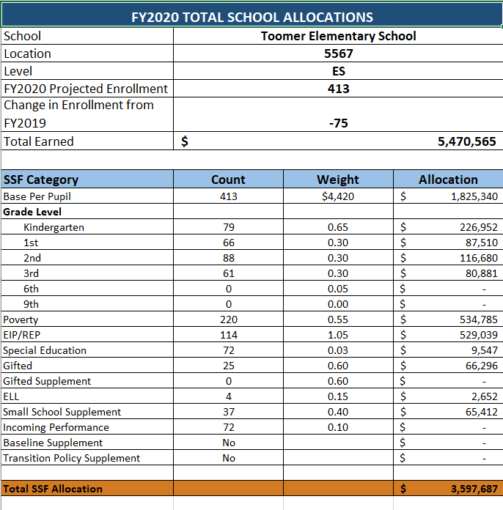
School Allocation
le
Notes:
For FY20, APS is continuing to increase equity within the District and the flexibility principals have in regards to our schools budgeted funds. The new Student Success Funding Model (SSF) allocates dollars to schools based on the number of enrolled students and receives a funding "weight" based on need. This year, student characteristics were weighted based on:
Grade Level –
K
1st through 3rd
6th
9th
Poverty – Weighted for all Direct Certification enrolled students.
Beginning Performance – Weighted Middle School and High School students entering with beginner’s performance on milestones.
ESOL – Weighted for all ESOL designated students in order to supplement due to ESOL staff being locked.
Special Education - Weighted for all Special Education students.
Gifted – Weighted and measured by number of students in the Gifted Program
Small School Supplement – Weighted for low enrollment schools
ES – 500
MS – 600
HS – 700
As you can see, our projected enrollment for FY19 is _______, we increased/decreased by __________ from last year.
We received the following weights for our student characteristics: (Below is just for the script, principals need to insert their school’s characteristics)
Grade Level
Poverty
Special Education
Gifted
Gifted Supplement
ELL
Small School Supplement

Slide 18
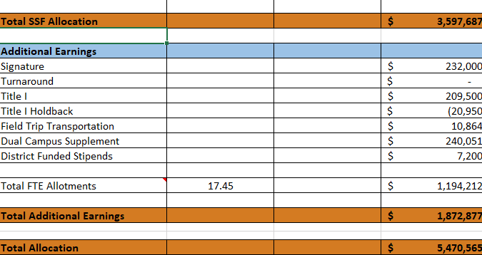
School Allocation
Notes:
Additionally, we received money for signature programming, turnaround, Title I and FTE Allotments.

Slide 19
What’s Next?
January:
  GO Team Initial Budget Session (Jan. 22nd-31st)
February:
  One-on-one Associate Superintendent discussions
  Cluster Planning Session (positions sharing, cluster alignment, etc.)
  Program Manager discussions and approvals
  GO Team Feedback Session where budget will be presented (need to schedule)
  HR Staffing Conferences (February 25th - March 1st)
• March:
  Final GO Team Approval (March 1st - March 15th)
Notes:
In February, we will meet again to discuss how the school’s budget has been allocated to support the programmatic needs and FY20 key strategic priorities.
If think we need to continue our budget conversations, we will schedule additional meetings. My goal is to make sure your voices are reflected in our school’s budget.
I will also be meeting with my Associate Superintendent, program managers and other key leaders to go over our budget and to make sure the school is meeting the standards of service and appropriately staffing.
During the week of Feb. 25th -March 1st , HR Staffing Conferences will be held. At this meeting, I will present my plan for staff utilization, resource distribution and plan for staffing implications.
We will need to approve the budget at the ________ meeting.

Slide 20

Questions?
Thank you for your time and attention.
Notes:
IF YOU FEEL YOUR TEAM IS READY TO APPROVE THE DRAFT BUDGET, PLEASE DO SO. PLEASE REMIND THEM THAT YOU MAY NEED TO MEET WITH THEM AGAIN, IF THERE ARE CHANGES FROM YOUR MEETINGS WITH DISTRICT LEADERSHIP. LET THEM KNOW YOU WILL KEEP THEM INFORMED!!

Slide 21
Notes:
IF YOU FEEL YOUR TEAM IS READY TO APPROVE THE DRAFT BUDGET, PLEASE DO SO. PLEASE REMIND THEM THAT YOU MAY NEED TO MEET WITH THEM AGAIN, IF THERE ARE CHANGES FROM YOUR MEETINGS WITH DISTRICT LEADERSHIP. LET THEM KNOW YOU WILL KEEP THEM INFORMED!!

Slide 22
Focus Area Descriptors
Strategic Plan Categories | District Descriptions of Categories
Academic Program | Our students will be well-rounded individuals who possess the necessary academic skills and knowledge and are excited about learning.
Talent Management | We will retain an energized and inspired team of employees who are capable of advancing ever-increasing levels of achievement for students of all backgrounds.
Systems & Resources | We will improve efficiency (productivity, cost, etc.) while also making decisions (including resource allocations) that are grounded in a strategic academic direction and data.
Culture | We will build trust with the community, and we will have engaged stakeholders (employees, students, parents, community members, partners, etc.) who are invested in the mission and vision and who support the creation of student-centered learning communities.
Notes:
I have printed the terms on the next two slides for your convenience. I want to just go over them so we will all be on the same page as we move forward in this process. If you have any questions, please don’t hesitate to ask.

Slide 23
Description of Strategy Categories
Budget Parameters – FY20 funding priorities from the school’s 3-5 year strategic plan, ranked by the order of importance
Strategies – Lays out specific objectives for schools improvement
Request – “The Ask”. What needs to be funded in order to support the strategy?

Slide 24
FY20 Budget Parameters
FY20 School Priorities | Rationale
Close the achievement gap by increasing the performance of our sub groups | To provide an equity-conscious education to our students we must ensure we meet students at their various academic abilities. By decreasing class size as much as the budget will allow will enable teachers to provide targeted instruction.
Improve Teacher Efficacy in IB and Core Content Areas | Students are making improvements in literacy as evidenced by increased lexile scores, assessment data, and daily classwork. Despite this growth in ELA, students are not showing evidence of success in mathematical concepts. Through additional human capital targeted in math instruction, teachers will build their knowledge base and pedagogical practices.
Notes:
Review the priorities that the GO Team has developed and the rationale for these priorities

Slide 25
FY20 Strategic Plan Break-out
Priorities | Focus Area | Strategies | Requests | Amount
Close the achievement gap | Academic Program | Implement a balanced Literacy Program K-5 | Purchase of new Literacy Curriculum for k-5 | 136,000
Close the achievement gap | Academic Program | Implement IB and CORE Content | 22 Core Teachers KK 16-1 1st 16-1 2nd 22-1 3rd 20-1 4th 21-1 5th 18-1 | 2,000,000
Close the achievement gap | Academic Program | Enrichment teachers | Gifted PE Art Music World Language Band | 480,000
Close the achievement gap | Academic Program | Support Staff | RTI Specialist Nurse Social Worker Counselor Psychologist Non Instructional Para | 335,000
Improve Teacher Efficacy in IB and Core Content Areas | Academic Program | On going, job embedded professional development and curriculum planning | Literacy Coach IB Coach | 340,000
Improve Teacher Efficacy in IB and Core Content Areas | Academic Program | On going, job embedded professional development and curriculum planning | Math Coach | 100,000
Notes:
For the next few slides, I will show you how I have allocated the budget to support our strategic priorities.
Based on our strategic priorities and funds we received, here is a break-out of the priorities, which focus area it addresses, the strategies that will be implemented, the purchase request, which funding source was used and the amount.

Slide 26
Plan for FY20 Leveling Reserve
Priorities | Focus Area | Strategies | Requests | Amount
Improve Teacher Efficacy in IB and Core Content Areas | Academic Program | Professional Development on Researched evidenced instructional practices | Send a team to International Literacy Annual Conference | $25,000
Close the achievement gap | Academic Program | Balanced Literacy Curriculum | Materials such as larger Leveled Library | $25,000
Close the achievement gap | Academic Program | Implement IB and CORE Content | Instructional and Consumable materials for the Early Learning Center | $21,000
Notes:
This slides represent the priorities we will fund if we receive additional money from Title I and the Leveling Reserve. When we approve the budget we will approve both so that we will not have to schedule another meeting if the funds are made available.
Before I turn it back over to the Chair for the next slide, I want to thank you for your hard work and support this year. I will keep you informed as we move through the budget process. (Please inform Chair that they will facilitate the discussion for the last slide)

Slide 27
Plan for FY20
Title I Holdback and Family Engagement Funds
Priorities | Focus Area | Strategies | Requests | Amount
Inform and engage the school Community | Culture | Family nights | Transportation for informational events. | 3,500
Inform and engage the school Community | Culture | Family nights | Materials for printing etc. | 3,000
Close the achievement gap | Academic Program | Implement IB and CORE Content | Necessary consumable materials for teachers | $21,000
Notes:
This slides represent the priorities we will fund if we receive additional money from Title I and the Leveling Reserve. When we approve the budget we will approve both so that we will not have to schedule another meeting if the funds are made available.
Before I turn it back over to the Chair for the next slide, I want to thank you for your hard work and support this year. I will keep you informed as we move through the budget process. (Please inform Chair that they will facilitate the discussion for the last slide)

Slide 28
Questions to Consider
Are our school’s priorities (from your strategic plan) reflected in this budget?
  Are new positions and/or resources included in the budget to address our major priorities?
  Do we know (as a team) the plan to support implementation of these priorities beyond the budget (ex. What strategies will be implemented)?
  What tradeoffs are being made in order to support these priorities?
2. How are district and cluster priorities reflected in our budget?
  Cluster priorities- what staff, materials, etc. are dedicated to supporting our cluster’s priorities?
  Signature programs- what staff, materials, etc. are dedicated to supporting our signature program?
  Are there positions our school will share with another school, i.e. nurse, counselor?
Notes:
CHAIR - Our final task for today! Here are questions that we need to consider to ensure we have a good working draft budget. Let’s walk through them together.

